Slide 1
REMOTELY OPERATED UNDERWATER VEHICLE HARDWARE SYSTEM
Name: Luqman Hakim bin Mohamad Salmi
Matric Number: 1718219
Section: 1

Slide 2
Main Components
Physical design for various applications
Propulsion system and actuators
Navigation system and control
Data collection
Data transmission
Power management

Slide 3
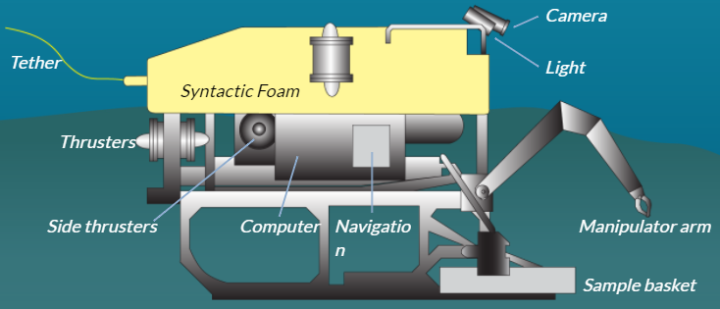
Physical Design
The base frame of ROV are usually built with lightweight materials
The light and camera acts as the ‘eye’ of the ROV
The manipulator arm is do tasks such as taking samples
The thrusters are used to navigate underwater
The tether/umbilical cable is a wire connecting the ROV to the ship
Basic design of ROV

Slide 4
Physical Design
There are several types of ROV for various applications which consists of:
Micro ROV
Mini ROV
General ROV
Inspection Class ROV
Light Work Class ROV
Heavy Work Class ROV
Trenching and Burial ROV

Slide 5
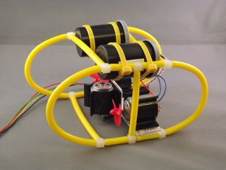
Physical Design (Micro ROV)
Small sized
Weighs below 3kg
Used to explore minuscule cavities or pipeline cracks

Slide 6
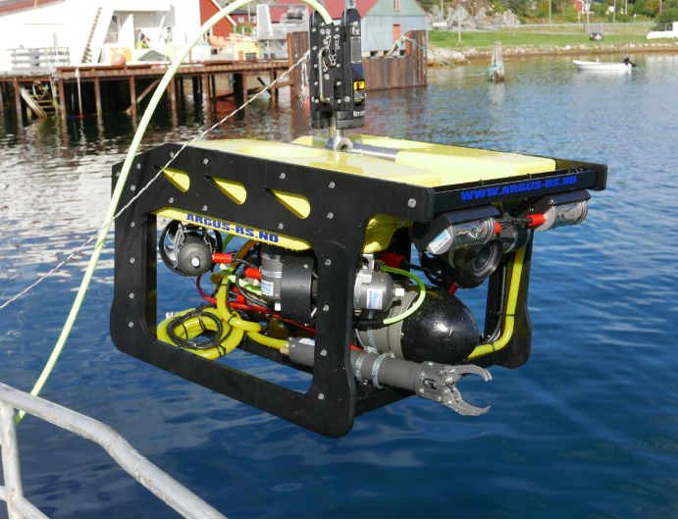
Physical Design (Mini ROV)
Weighs around 15kg
Requires only one person to operate it from the boat
Used to carry out underwater expedition

Slide 7
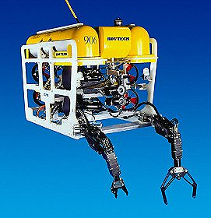
Physical Design (General ROV)
Usually below 5HP
Equipped with three-finger manipulators
Specially built to aid in light survey tasks

Slide 8
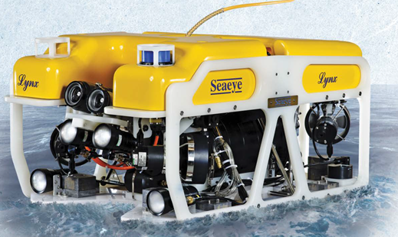
Physical Design (Inspection Class)
Generally smaller than workclass ROV
Used to assist with hydrographic survey
Usually used in pipeline surveys, jacket inspections and marine hull inspection of vessels

Slide 9
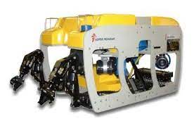
Physical Design (Light Work Class)
Generally below 50HP
Can support several manipulators
Allows a maximum working depth of 2000 meters

Slide 10
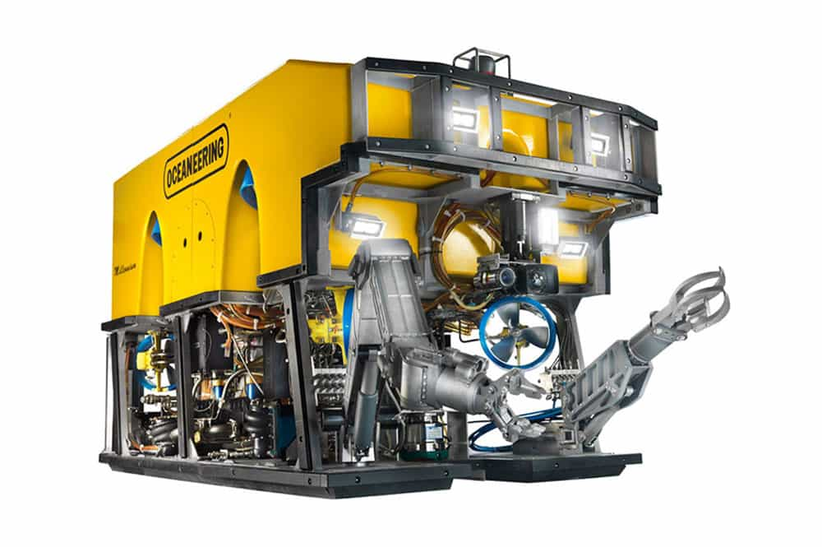
Physical Design (Heavy Work Class)
Supports below 220 HP
Can be modified to have multiple manipulators
Can achieve a depth of 3500 meters
Have a lifting payload of over 5000 kg
Commonly used in deep-water installations and subsea tie-ins

Slide 11
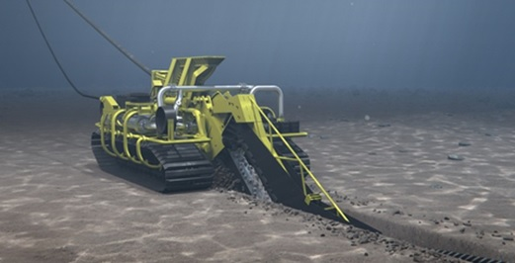
Physical Design (Trenching and Burial ROV)
Offers a 200-500HP range
Can be utilized till 6000 meters
Commonly used in cable laying, the safe creation of seabed trenches and the partial or complete anchoring of subsea components used in the oil and gas industry

Slide 12
Propulsion System and Actuator
Thrusters are used for the propulsion system of ROVs. There are three types of thrusters which consists of:
Electrical thrusters
Hydraulic thrusters
Ducted jet propulsion

Slide 13
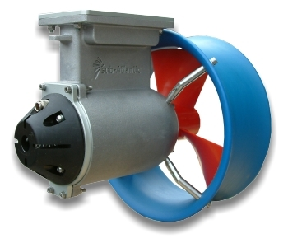
Propulsion System (Electrical Thrusters)
Commonly operated by DC motors
Usually, DC motors have high rpm which is not suitable for ROV applications
However, gearing can help match the efficient operational speed

Slide 14
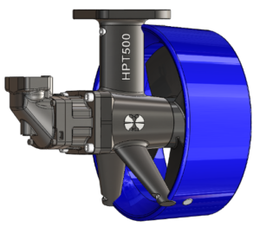
Propulsion System (Hydraulic Thrusters)
Operated by hydraulic motors
Usually used for heavy duty tooling for intervention

Slide 15
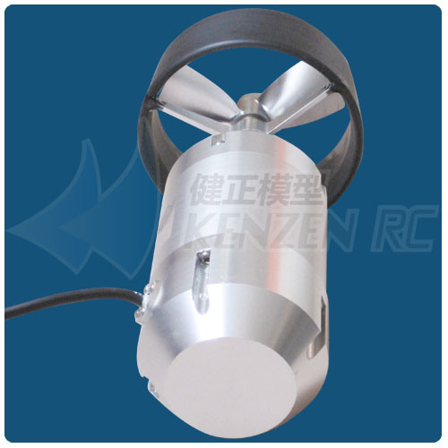
Propulsion System (Ducted Jet Propulsion)
Rarely used in ROV application
Can be used in the vicinity of loosely consolidated debris

Slide 16
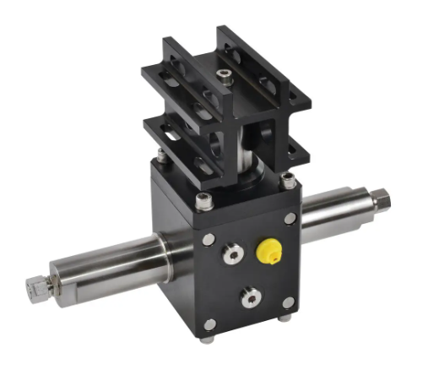
Actuator
Actuator used to mount camera on ROV
Have pan and tilt movements

Slide 17
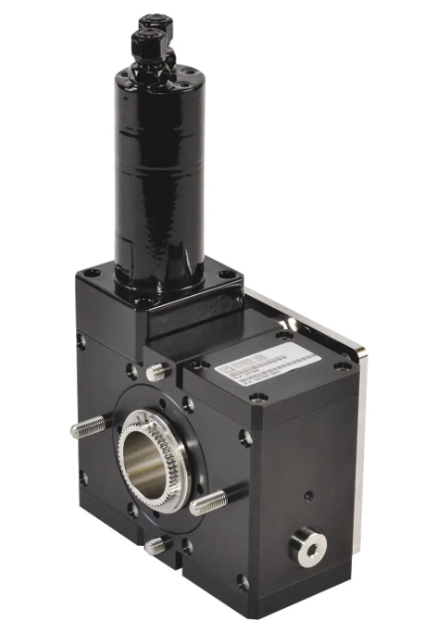
Actuator
Actuator used to rotate manipulator arm
Driven by hydraulic motor

Slide 18
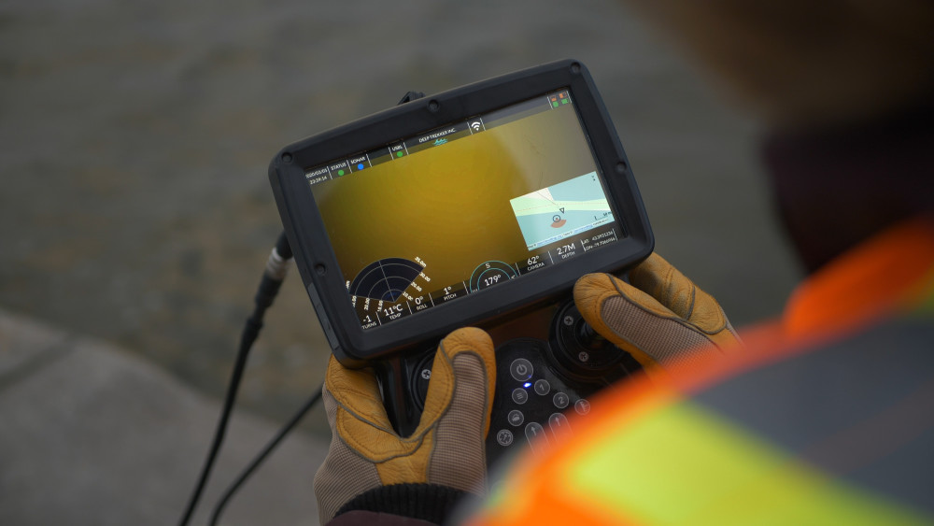
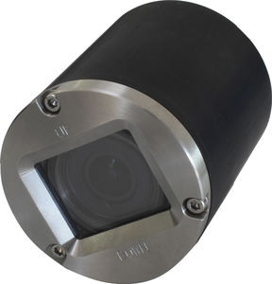
Navigation System (Camera)

Slide 19
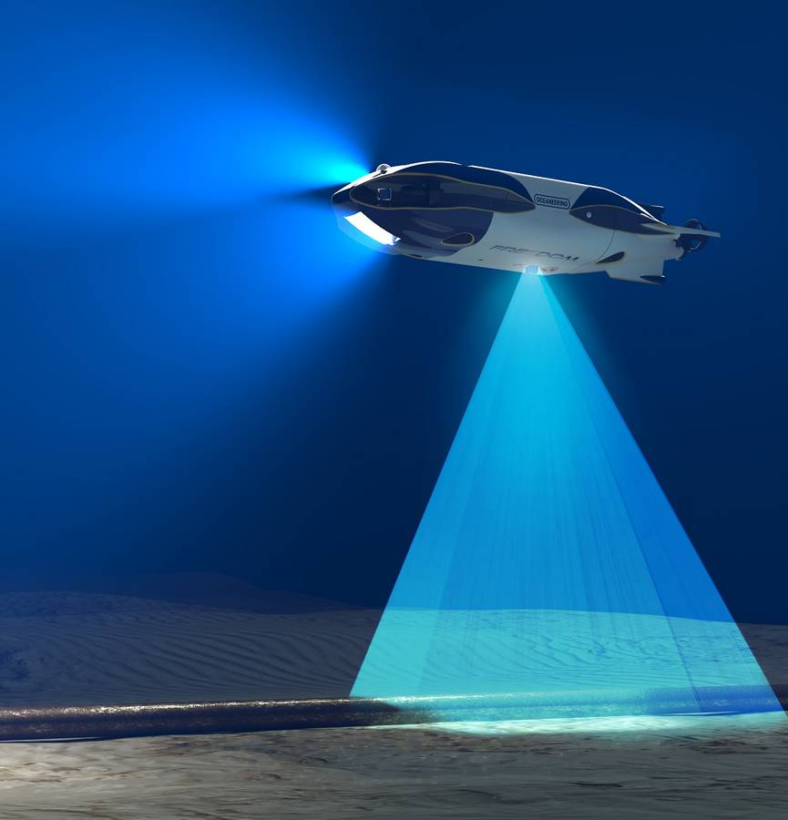
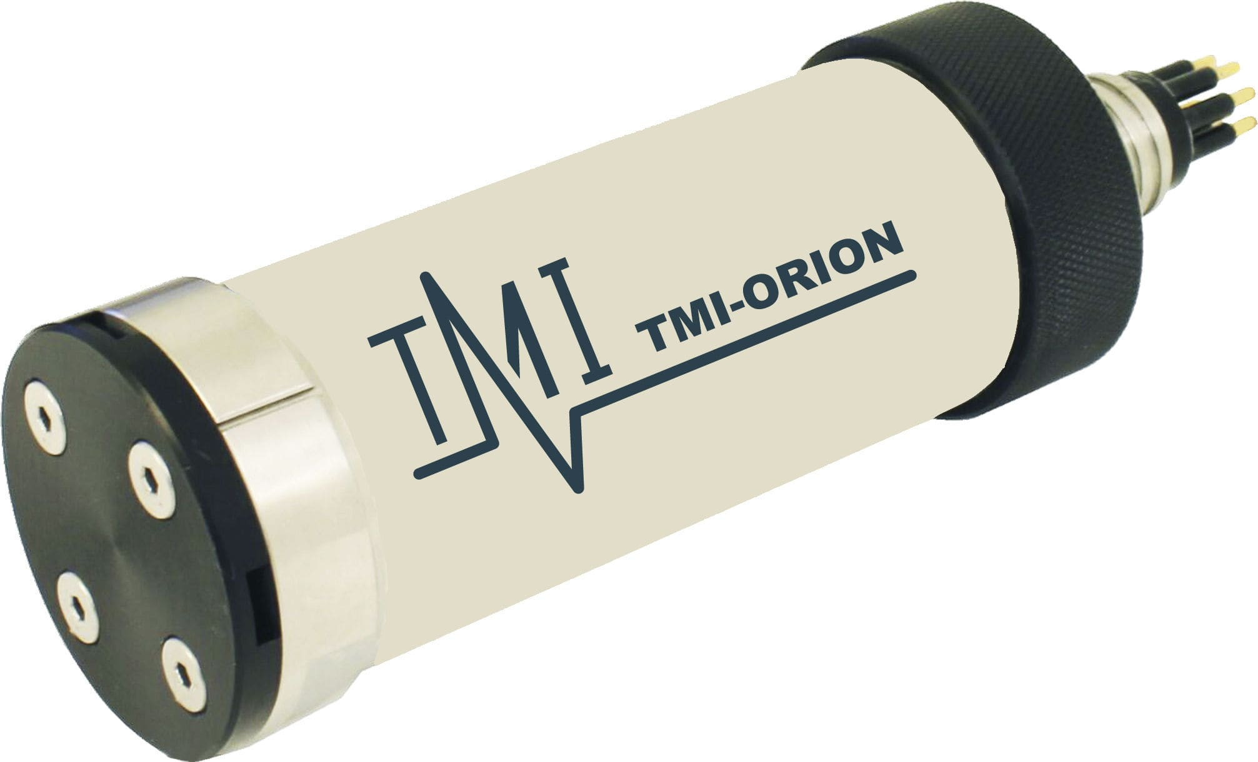
Navigation System (Depth Sensor)

Slide 20
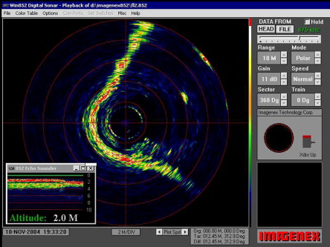
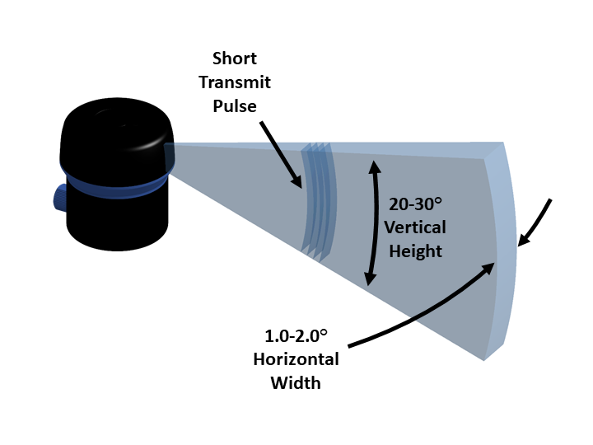
Navigation System (Sonar)

Slide 21
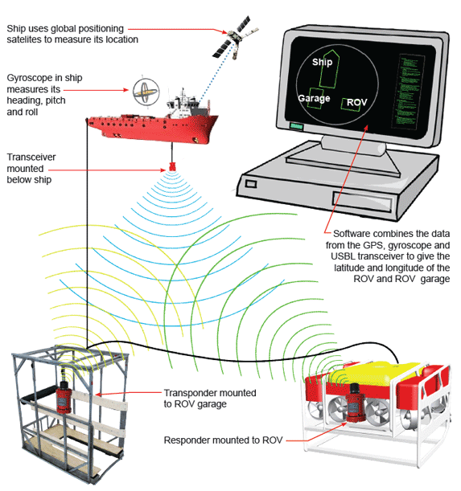
Data Collection and Transmission
Positioning system of ROV

Slide 22
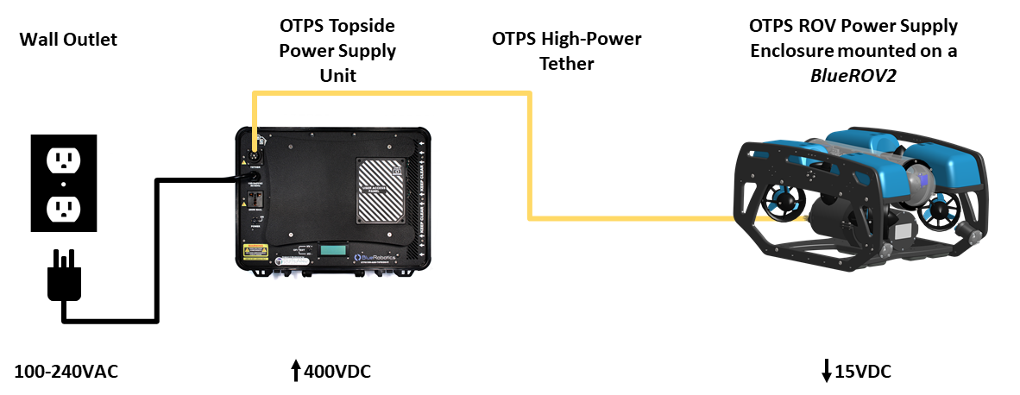
Power Management
Since ROV have tether/ umbilical cable attached, the power is supplied from a power source on board the ship

